Slide 1
Python for Data Science:
Python Introduction
Presented & Prepared by: Hussein El Amouri

Slide 2

What is Python?
“Python is an experiment in how much freedom programmers need. Too much freedom and nobody can read another's code; too little and expressive-ness is endangered.”
- Guido van Rossum
Notes:
Python was created to increase the creativity of programmers
Flexible and clear
And to make programming easier for those who are not from CS bckg

Slide 3
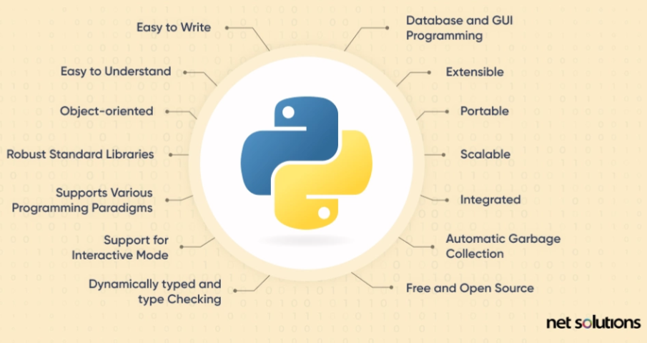
Why Python?
It’s easy to learn
Full-Featured
Strong Libraries
Open-sourced

Slide 4
Python
High-level
Human-readable and strong abstraction from machine language
Interpreted language
Line by Line is interpreted into machine language
Dynamically typed
No need to define data types

Slide 5
Python Installation
Follow: 02_Setup_Python.pdf in 1. Python Installation and Basics
You:
1.2.1. Installing Python (latest stable release - 3.9 or 3.10)
1.2.2. Installing and using Jupyter Notebook

Slide 6
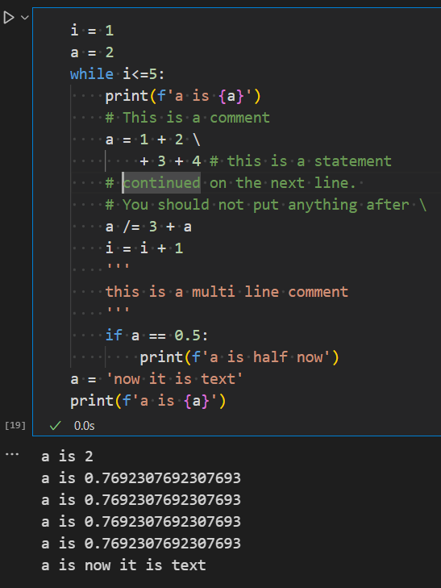
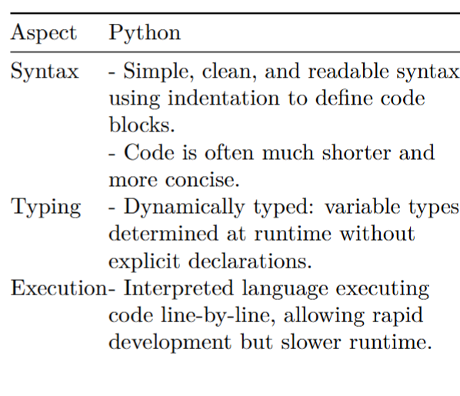
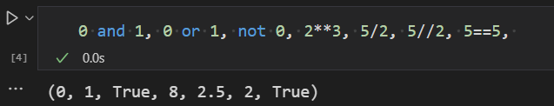
Python Basics

Slide 7
Python Basics
Refer to the Workshop material’s 1. Python Installation and Basics’
03_Python_Basic_Syntax.ipynb
04_Collections_and_Operators.ipynb
05_Control_Flow_Functions_and_Modules.ipynb

Slide 8
Numerical Analysis and Visualization Libraries
For Numerical Analysis:
You will Learn about Numpy and Pandas Libraries
For visualization:
You will learn about Matplotlib and Seaborn Libraries
For the hands-on, refer to ‘ 2. Numerical Analysis and Visualization Libraries’ part of the workshop

Slide 9
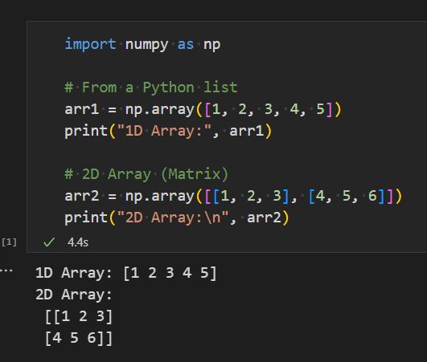
Numpy: Numerical Python
Is used for:
Efficient numerical computing
Foundation for many other scientific libraries (pandas, scikit-learn, etc)
Multi-dimensional arrays (ndarray)
Mathematical operations on arrays and matrices
Linear algebra, statistics, Fourier transforms, and more
Memory efficient

Slide 10
Numpy: Numerical Python
Hands-On Time

Slide 11
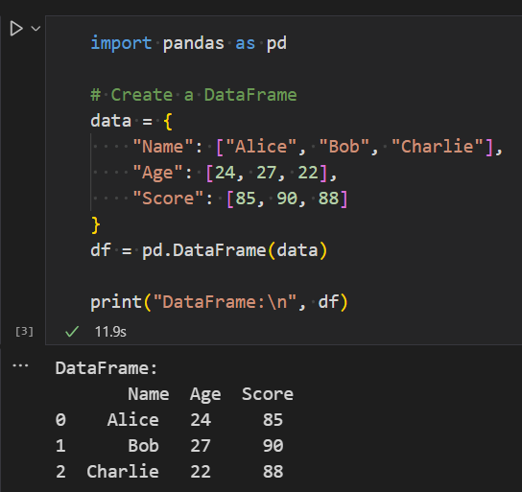
Pandas: Data Frames (Table)
Designed for data manipulation and analysis
Built on Numpy
Well-suited for Tabular data
Provides a large number of methods and functions for
Data visualization
Data Analysis
Pandas objects:
Series: A 1D labeled array of types (integer, string, float, Python objects, etc.)
DataFrame: A 2D data structure with labeled axes (rows and columns)

Slide 12
Pandas: Data Frames (Table)
Hands-On Time

Slide 13
Matplotlib an Seaborn
Matplotlib: Base scientific tool for plotting; low-level library
Seaborn: Built on matplotlib; high-level plotting library
Both provides:
Functions to create attractive and statistically meaningful visualizations
You can mix Seaborn and Matplotlib commands in the same figure
Hands-On Time

Slide 14
Scikit-Learn: Python Library for ML
High-level machine learning module
Built on top of NumPy, SciPy, and matplotlib
Supports a wide range of ML algorithms:
Supervised
Classification/Regression
E.g SVM, KNN, Decision Trees, Linear Regression, Logistic Regression
Unsupervised
Clustering, Matrix Factorization, Dimensionality reduction
E.g Kmeans, NMF, PCA
Supports a wide range of tools for Data Preprocessing
Includes tools for model selection, cross-validation, and hyperparameter tuning

Slide 15
Scikit-Learn: Workflow
Import the needed model (method) from the scikit-learn package
Intialize the model
Fit model
Make Predictions
Hands-On Time

